Slide 1
PA 103: Introduction to Microeconomics

Slide 2
Lecture 10 Elasticity and Its Application

Slide 3
Elasticity and Its Application
Price Elasticity of Demand and Total Revenue
Total revenue (TR) of a seller equals the price of a good times the quantity of the good sold.
For example, if a hamburger vendor sells 100 hamburgers today at $1.50 each, its total revenue is $150.
Suppose the hamburger vendor raises the price of a hamburger to $2. What do you predict will happen to total revenue?
Whether total revenue rises, falls, or remains constant after a price change depends on whether the percentage change in the quantity demanded is less than, greater than, or equal to the percentage change in price respectively.

Slide 4
Elasticity and Its Application
Price Elasticity of Demand and Total Revenue
Elastic Demand and Total Revenue
If demand is elastic, a price rise decreases total revenue.
Demand is elastic: P ↑ → TR ↓
On the other hand, if demand is elastic, a price fall increases total revenue.
Demand is elastic: P ↓ → TR ↑

Slide 5
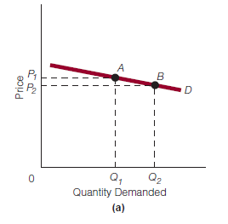
Elasticity and Its Application
Price Elasticity of Demand and Total Revenue
Elastic Demand and Total Revenue

Slide 6
Elasticity and Its Application
Price Elasticity of Demand and Total Revenue
Inelastic Demand and Total Revenue
If demand is inelastic, a price rise increases total revenue.
Demand is elastic: P ↑ → TR ↑
On the other hand, if demand is elastic, a price fall decreases total revenue.
Demand is elastic: P ↓ → TR ↓

Slide 7
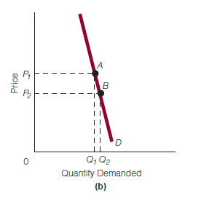
Elasticity and Its Application
Price Elasticity of Demand and Total Revenue
Inelastic Demand and Total Revenue

Slide 8
Elasticity and Its Application
Price Elasticity of Demand and Total Revenue
Unit Elastic Demand and Total Revenue
If demand is unit elastic, the percentage change in quantity demanded equals the percentage change in price.
If price rises, the quantity demanded falls by the same percentage as the percentage rise in price. Total revenue does not change.
If price falls, the quantity demanded rises by the same percentage as the percentage fall in price. Again, total revenue does not change.

Slide 9
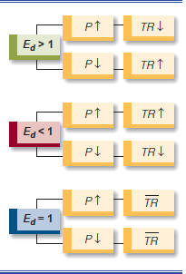
Elasticity and Its Application
Price Elasticity of Demand and Total Revenue
For a review of the relationship between price elasticity of demand and total revenue, see Exhibit 6.

Slide 10
Elasticity and Its Application
Price Elasticity of Demand Along a Straight-Line Demand Curve
The price elasticity of demand for a straight line downward-sloping demand curve varies from highly elastic to highly inelastic.
Consider the price elasticity of demand at the upper range of the demand curve in Exhibit 7(a).
Whether the price falls from $9 to $8 or rises from $8 to $9, using the price elasticity of demand formula, we calculate the price elasticity of demand as 5.66.

Slide 11
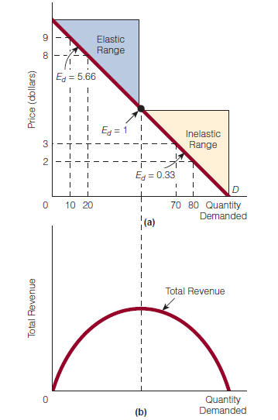
Elasticity and Its Application
Price Elasticity of Demand Along a Straight-Line Demand Curve

Slide 12
Elasticity and Its Application
Price Elasticity of Demand Along a Straight-Line Demand Curve
Now consider the price elasticity of demand at the lower range of the demand curve in Exhibit 7(a).
Whether the price falls from $3 to $2 or rises from $2 to $3, we calculate the price elasticity of demand as 0.33.
In other words, along the range of the demand curve identified, price elasticity goes from being greater than 1 (5.66) to being less than 1 (0.33).

Slide 13
Elasticity and Its Application
Price Elasticity of Demand Along a Straight-Line Demand Curve
Obviously, on its way from being greater than 1 to being less than 1, price elasticity of demand must be equal to 1.
In Exhibit 7(a), we have identified the price elasticity of demand as equal to 1 at the midpoint of the demand curve.
The elastic and inelastic ranges along the straight-line downward-sloping demand curve can be related to a total revenue curve [Exhibit 7(b)].

Slide 14
Elasticity and Its Application
Price Elasticity of Demand Along a Straight-Line Demand Curve

Slide 15
Elasticity and Its Application
Price Elasticity of Demand Along a Straight-Line Demand Curve
If we start in the elastic range of the demand curve in Exhibit 7(a) and lower price, total revenue rises, as shown in Exhibit 7(b).
When price has fallen enough that we move into the inelastic range of the demand curve in part (a), further price declines simply lower total revenue, as shown in part (b).
Therefore, total revenue is at its highest— its peak—when price elasticity of demand equals 1.

Slide 16
Readings
Roger A. Arnold- Microeconomics, 10th Edition, Chapter – 6.

Slide 17


Slide 18
Thank You

